Slide 1
History of racism and antisemitism (US and Europe) and psychological mechanisms that favor prejudices and bias
Presentation by Gunther Jikeli
for the
Datathon & Hackathon Competition on Hate Speech
January 15, 2023

Slide 2


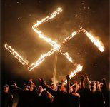

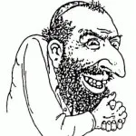
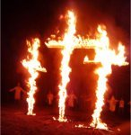


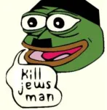
(Offensive) Hate symbols
National Socialist Legion
88
For a list of hate symbols, see https://www.adl.org/resources/hate-symbols/search?keywords=&sort_by=title&page=1
18
NWO
311
ZOG
Blood & Honor
Blood & Soil
"For God, Race and Nation"

Slide 3
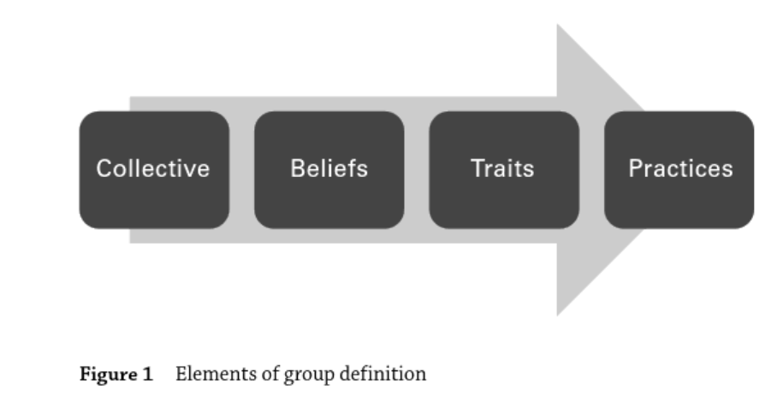
In: Berger: Extremism
Joining in-groups is probably unavoidable for humans.
The world is organized in groups, notably nations (since the 19th century).
Identities are fluid and contested
Groups need to know who’s in/ who’s eligible/ who’s ineligible but still in/ out?) – extremists are more rigid and tend to purge the in-group
Bias and identity/belonging are closely related.

Slide 4
Psychological mechanisms that favor prejudices
The fundamental attribution error describes perceivers' tendency to underestimate the impact of situational factors on human behavior and to overestimate the impact of dispositional factors. For instance, people often tend to believe that aggressive behavior is caused by aggressive personality characteristics (dispositional factor) even though aggressive behavior can also be provoked by situational circumstances (situational factor).
The hostile attribution bias is the tendency to interpret the behavior of others, across situations, as threatening, aggressive, or both. People who exhibit the HAB think that ambiguous behavior of others is hostile and often directed toward them, while those who do not exhibit the HAB interpret the behavior in a nonhostile, nonthreatening way.
Confirmation bias refers to processing information by looking for, or interpreting, information that is consistent with one's existing beliefs. This biased approach to decision making is largely unintentional and often results in ignoring inconsistent information.
Source: Sage Encyclopedia of Social Psychology

Slide 5
Hist. Period | The Role of the “Other” outside society and increasingly inside society | Views of Others
BC | Empires BC did not have much contact beyond the empires other than going to war and often enslaving conquered populations | Not much is known but we can assume that views of people outside the empires were seen as a potential threat and needed to be subjugated.
Ancient Greece | The word “barbarian” describes all non-Greek-speaking peoples. | Barbarians
Roman Empire | In the Roman Empire, the word “barbarian” refers to all foreigners who lacked Greek and Roman traditions, especially the tribes and armies putting pressure on Rome’s borders | Barbarians
Middle Ages in Europe | Not much contact with peoples outside Europe. Until Marco Polo: mostly fantasies Wars with Empires, such as the Ottoman Empire, some trade | "India" = wealth, gold, pearls, and spices. It was a land of griffons, monsters, and demons Unknown peoples: Monstrousness, sin, and blackness Muslims/Arabs were feared
From the end of the 15th century: colonization | Encounters with the Other in international trade, settlements, and systems of colonialism of emerging city and nation states. European representations were hierarchically ordered around the view that Europeans were superior by virtue of their ‘civilisation’ and achievements. The condition of the Other was seen as proof of that interpretation. | Russia and Central Asia: ‘barbarous’, ‘tyrant’ or ‘infidel’ The Americas, Africa and India: physical characteristics, such as skin color, hair type, partial or complete nakedness, portrayed as savages and/or cannibals or harmless/kind but in some cases also praise about their strength, courage, agility, and hunting and fishing skills and an idealization of the “noble savage.”
Transatlantic Trade, including Slave Trade | Profits in “the new world” meant increasingly subjugation, displacement, exploitation, and enslavement of indigenous and African peoples – increasingly enforced militarily. | Not Christian, emphasis on dark skin color and nakedness, Cursed by God potent sexuality, bestial character, cannibalism, supposed physical similarities between Africans and apes, savage, lazy, superstitious, ferocious, and coward, as well as polite, and noble
Enlightenment, emergence of Science and Nation States | By the 19th century, the idea that every human being should be treated equally before the law and that there are natural rights for every human being had become widely accepted. But how to justify the continuation of unequal treatment? “Race theory” “Race” allegedly determines psychological and social capacities. Combination of “race theory” with social Darwinism justified even genocide in the name of “racial hygiene.” | Dehumanization “Race theory” relate character traits and intelligence to “races” and justified hierarchization of races. Other races were seen as separate (that must not be mixed) and inferior
Independence of the USA | 1808: Importation of slaves becomes illegal, but slavery is still legal and large parts of the economy are still based on slavery until the Civil War. 1865: Civil War ends. 13th Amendment abolishes slavery | Black people are seen as slaves
U.S. after the Civil War (1861-1865) | Slavery is illegal but racist backlash. KKK was founded in 1866 1868: Fourteenth Amendment gives Blacks full citizenship, equal protection, due process, privileges and immunities. State laws in the South established different rules (“Jim Crow” laws) = Racist Segregation | “Jim Crow” was a derisive slang term for a black man. “The African American in antebellum times was, as the stereotype held, reliable, faithful, hardworking, malleable. Indeed, one entrusted one’s children, one’s property to such people. Now, of a sudden, the African American becomes demonized, a threat, a lascivious beast roaming the countryside of the South, people loosed by the end of slavery and now upon us like locusts.” L. Lewis.
U.S. after the Civil Rights Movement | Civil Rights Act of 1964 outlaws discrimination based on race, color, religion, sex, national origin, and later sexual orientation and gender identity. The Voting Rights Act of 1965 removed barriers to black enfranchisement. However, the legacy of racism still affects Americans | Racist action is illegal but racist attitudes still exist among many (Openly among white nationalists). Disagreement in society on how to combat racism and “racial” inequity

Slide 6
Hist. Period | Views of Others
BC | Not much is known but we can assume that views of people outside the empires were seen as a potential threat and needed to be subjugated.
Ancient Greece and Roman Empire | Barbarians
Middle Ages in Europe | "India" = wealth, gold, pearls, and spices. It was a land of griffons, monsters, and demons Unknown peoples: Monstrousness, sin, and blackness Muslims/Arabs were feared
From the end of the 15th century: colonization | Russia and Central Asia: ‘barbarous’, ‘tyrant’ or ‘infidel’ The Americas, Africa and India: physical characteristics, such as skin color, hair type, partial or complete nakedness, portrayed as savages and/or cannibals or harmless/kind but in some cases also praise about their strength, courage, agility, and hunting and fishing skills and an idealization of the “noble savage.”
Transatlantic Trade, including Slave Trade | Not Christian, emphasis on dark skin color and nakedness, Cursed by God potent sexuality, bestial character, cannibalism, supposed physical similarities between Africans and apes, savage, lazy, superstitious, ferocious, and coward, as well as polite, and noble
Enlightenment, Science and Nation States | Dehumanization “Race theory” relates character traits and intelligence to “races” and justifies the hierarchization of races. Other races were seen as separate (that must not be mixed) and inferior
Independence of the USA | Black people are seen as slaves
U.S. after the Civil War (1861-1865) | “The African American in antebellum times was, as the stereotype held, reliable, faithful, hardworking, malleable. Indeed, one entrusted one’s children, one’s property to such people. Now, of a sudden, the African American becomes demonized, a threat, a lascivious beast roaming the countryside of the South, ….” L. Lewis.
U.S. after the Civil Rights Movement | Racist action is illegal but racist attitudes still exist among many (openly among white nationalists). Disagreement in society on how to combat racism and “racial” inequity

Slide 7
Historical Period | Major real or perceived problems and ills of society | False accusations against Jews
Early Christianity in the tradition of Judaism | What is the true belief in the prophets and scripture? What about the covenant with God? | “Jews killed Jesus Christ.” → Jews reject truth and are evil. “Jews have not accepted the new covenant and are therefore condemned to be dispersed and live in misery.”
Christianity separates from Judaism | Forming a Christian identity and canon of scripture. | “Jews are the enemies of Christians.”
Early Islam | The Quran has many stories that are similar but somewhat different from stories in the Bible. | “Jews and Christians falsified sacred scripture.” → They are liars.
Islamic conquests | What to do with monotheistic minorities who do not convert? | Jews and Christians are religiously unclean (and should be separated and discriminated against)
Middle Ages, Crusades | Jerusalem must be liberated from the infidels by force. | → Served as justification for plunder and violence against Jews.
Middle Ages. Theological debates | Doctrine of the Eucharist (the belief that Jesus is present in the Eucharist, not merely symbolically or metaphorically) and thus Christians drink Jesus’ blood in the communion and eat his flesh. | “Jews desecrate the hosts and perform rituals with human blood.” “Jews abduct Christian children to perform rituals with human blood.”
Middle Ages. Increasing importance of finance | Financing becomes increasingly important. However, it is frowned upon and Jews are forced into this sector, exploiting their vulnerability (depts can be annulled by expulsing the Jews). | “Jews are greedy, immoral, and tight.”
Black Death | The inexplicable Plague | “Jews are responsible for the plague and poisoned wells.”
Reconquista | Spanish Inquisition: Heresy is the biggest threat to Christianity. (And even the “blood” has to be pure: "Limpieza de sangre“) | Invention of “Jewish blood.”
Reformation | True Christianity has to be defended against Papacy and other “enemies.” | “Jews are the enemies of Christians and cannot be converted.”
Enlightenment | Foundation of a new society and fight against the power of the Church and the aristocracy (= against the old order) | “Jews are backwards and ossified.” “Judaism is the source of the Church’s evil.”
Nationalism | Who is part of the nation? Who is not part of the nation? French model of the nation (all citizens born on French territory are French and equal) German model of the nation: ethnicity | French: Jews are not loyal citizens. They form a nation within the nation. German: Jews cannot be German by “race”
Rapid global changes of societies | Economic, technological, and social changes happen quickly without cohesive planning. New models of society emerge, such as liberalism, communism, capitalism, and socialism. | Jews are blamed for changes and ideologies of the opposite camp, allegedly ruling the world secretly.
Nazism | Strive for world dominance and homogenization of the German people | “Jews rule the world and are responsible for the decay of society.” -Everything evil is Jewish > Jews must be annihilated.
Post-WWII | Real and perceived ills of society and the world: From the political left: Wars, colonialism, human rights violations, racism. From the political right: Migration, liberalism, national history | -Israel/Jews are colonialists, warmongers, racist, white nationalist. - “Jews will not replace us.” Jews are responsible for liberalism (e.g. Soros is behind all liberal causes), Holocaust denial

Slide 8
Historical Period | New False Accusations Against Jews
Early Christianity in the tradition of Judaism
Christianity separates from Judaism
Early Islam
Islamic conquests
Middle Ages Crusades
Middle Ages. Theological debates
Middle Ages. Increasing importance of finance
Black Death
Reconquista
Reformation
Enlightenment
Nationalism
Rapid global changes of societies
Nazism
Post-WWII
Targeting religion: “Jews are evil,” and “Jews are enemies.”
Delusional accusations (e.g. blood libel, responsible for Black Death) → pogroms.
Targeting “blood” and race → most extreme violence
Targeting Israel and the Memory of the Holocaust

Slide 9
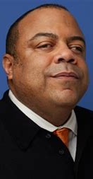
Eric Ward, Executive Director of Western States Center
“American White nationalism […] is a revolutionary social movement committed to building a Whites only nation, and antisemitism forms its theoretical core.”
“The successes of the civil rights movement created a terrible problem for White supremacist ideology. […]
How could a race of inferiors have unseated this power structure through organizing alone? For that matter, how could feminists and LGBTQ people have upended traditional gender relations […]?”

Slide 10

Manipulation techniques commonly used in misinformation:
emotionally manipulative language,
incoherence,
false dichotomies,
scapegoating, and
ad hominem attacks.
Source: Lewandowsky et al. Public policy and conspiracies: The case of mandates, Current Opinion in Psychology, 47, (101427), (2022). https://www.science.org/doi/10.1126/sciadv.abo6254
https://inoculation.science/inoculation-games/harmony-square/

